Slide 1
SQL explanation Expeditors
Amal Sharma

Slide 2
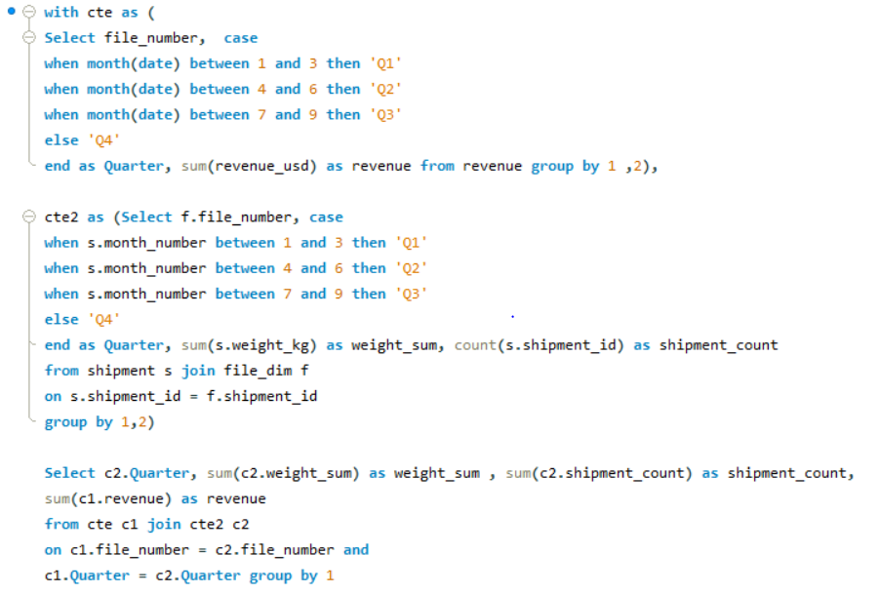
1. How much revenue is generated on how many shipments (shipment_id) and weights moved in each quarter (just call them Q1, Q2, Q3, and Q4, don't worry about year

Slide 3
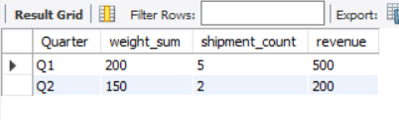
Result and Assumptions
Assumptions :
1. There exist multiple to multiple relation between Shipment_id and file_number
2. revenue.file_number can be same in multiple month. therefore, it need to be linked to file_dim.file_number and exact month to know its revenue in Quarter where as month is not present in file_dim. so we have to first calculate the revenue for quarter and weight & count quarter wise through shipment table and then it should be join for right result

Slide 4

2. How much revenue each client generated at the origin branch and level 1 region respectively?

Slide 5
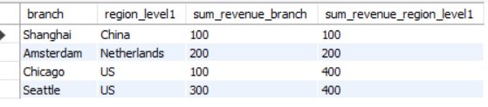
Result and Assumptions
Assumptions :
1. As region_level1 is higher hierachy therefor same sum will be reflected in multiple column as we are showing its lower hierarchy i.e. region as well

Slide 6
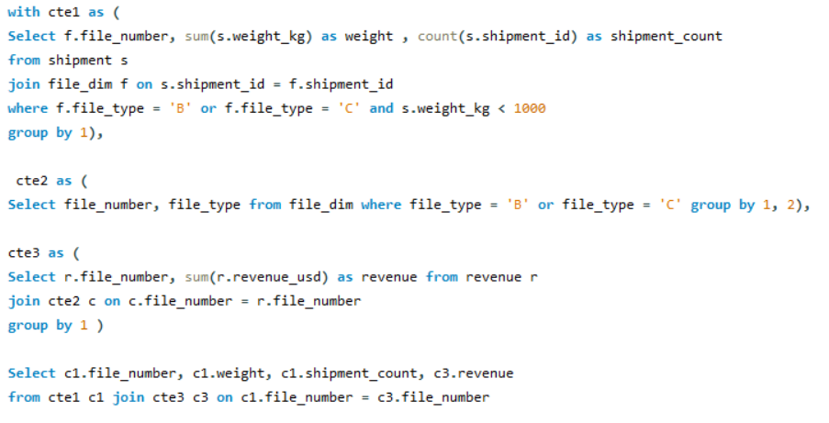
2. How much revenue is generated, and how many shipments are on each file with -- type B or C whose weight is below 1000kg?

Slide 7
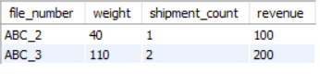
Result and Assumptions
Assumptions :
1. There exist multiple to multiple relation between Shipment_id and file_number
2. Because of multiple to multiple between Shipment_id and file_number. Also multiple to one relationship between Invoice and file_number we need to first calculate shipment count, weight, secondly calculate revenue for file number and then join them

